Slide 1
CUSTOMER MEET
CUDDALORE
Notes:
Title Slide

Slide 2

Notes:
Content Slide

Slide 3

Notes:
Divider Slide

Slide 4
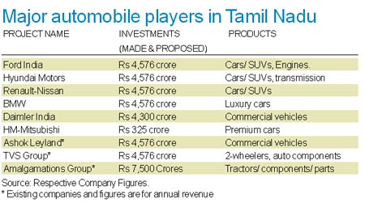
ASHOK LEYLAND SEEDED TAMILNADU- INDUSTRY HUB
Notes:
Agenda Slide

Slide 5
How many
Variants
6,00,000

Slide 6
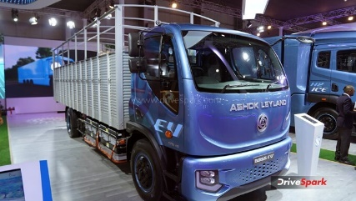
FUTURE -EV
Notes:
Content Slide

Slide 7
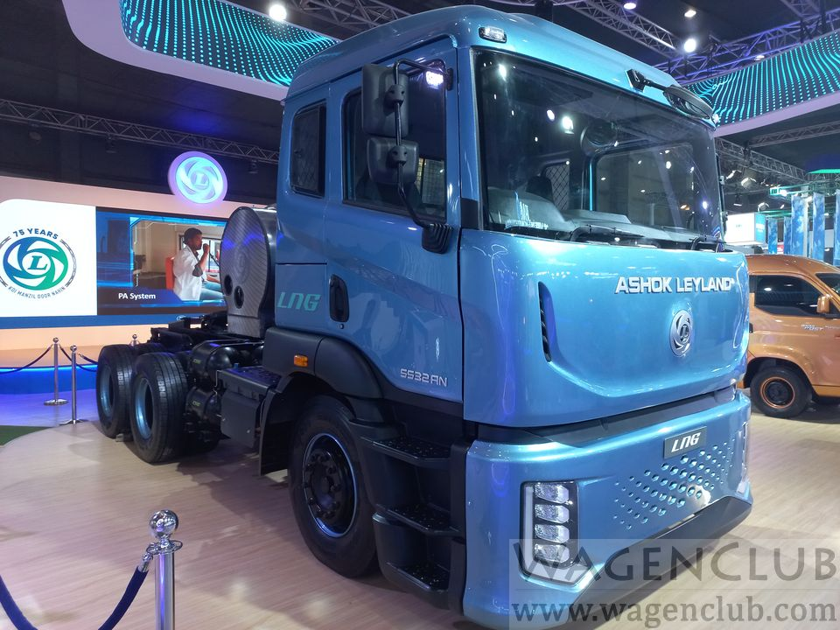
HYDROGEN -FUTURE
Notes:
Content Slide

Slide 8
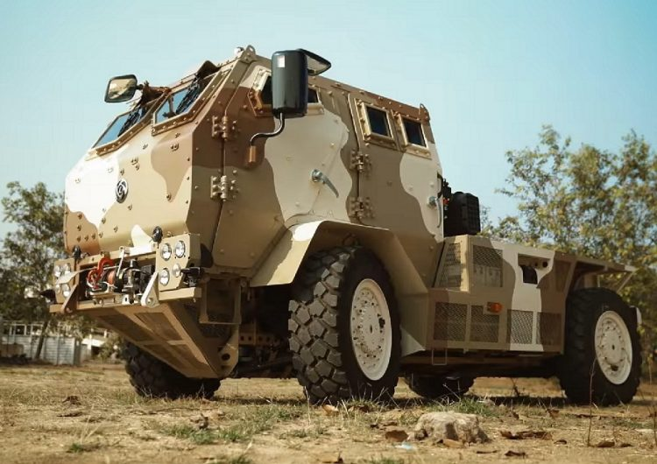
DEFENSE – BULLET PROOF
Notes:
Content Slide

Slide 9
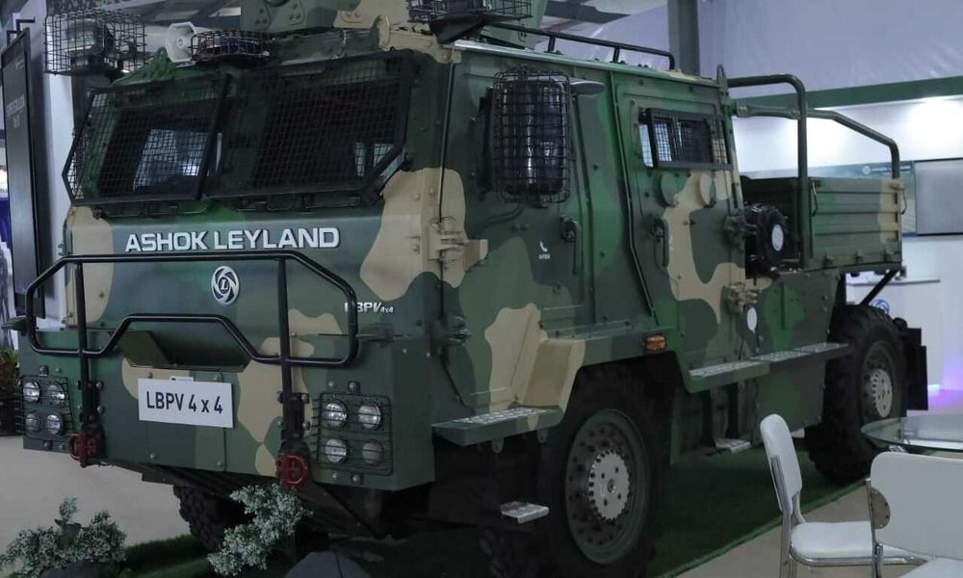
DEFENSE-2
Notes:
Content Slide

Slide 10

IMPACT OF OBD
BS IV -B

Slide 11
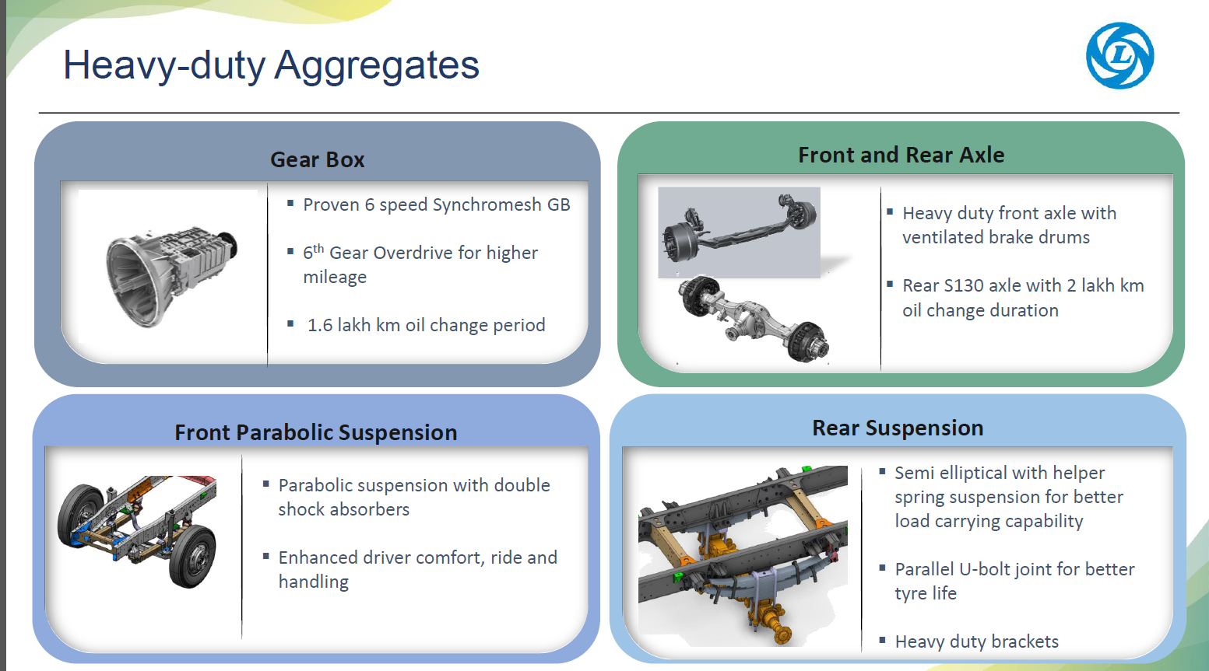
HEAVY DUTY AGGREGATES

Slide 12
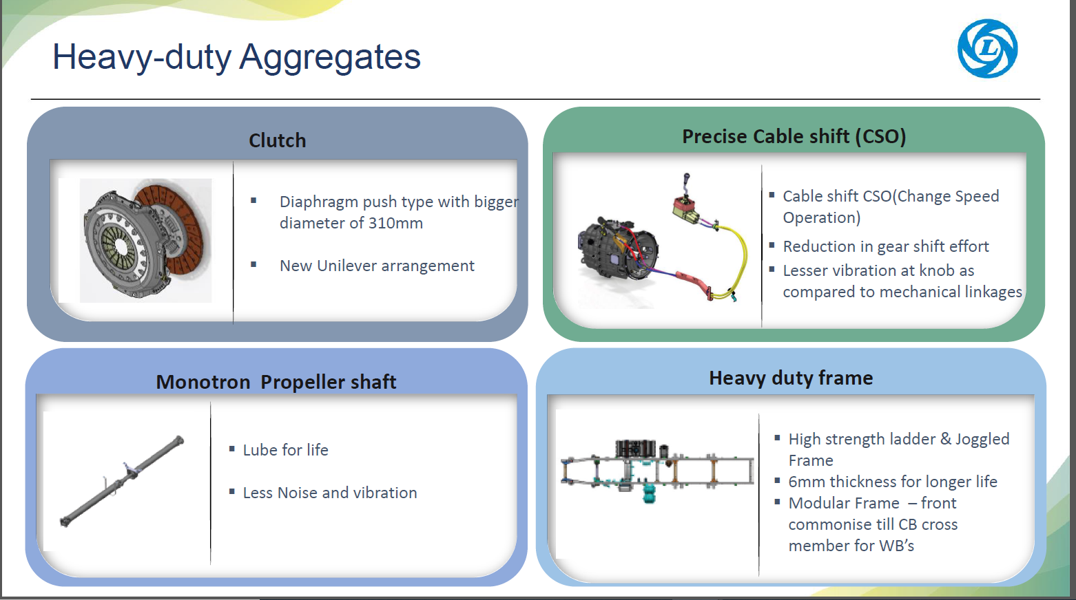

Slide 13
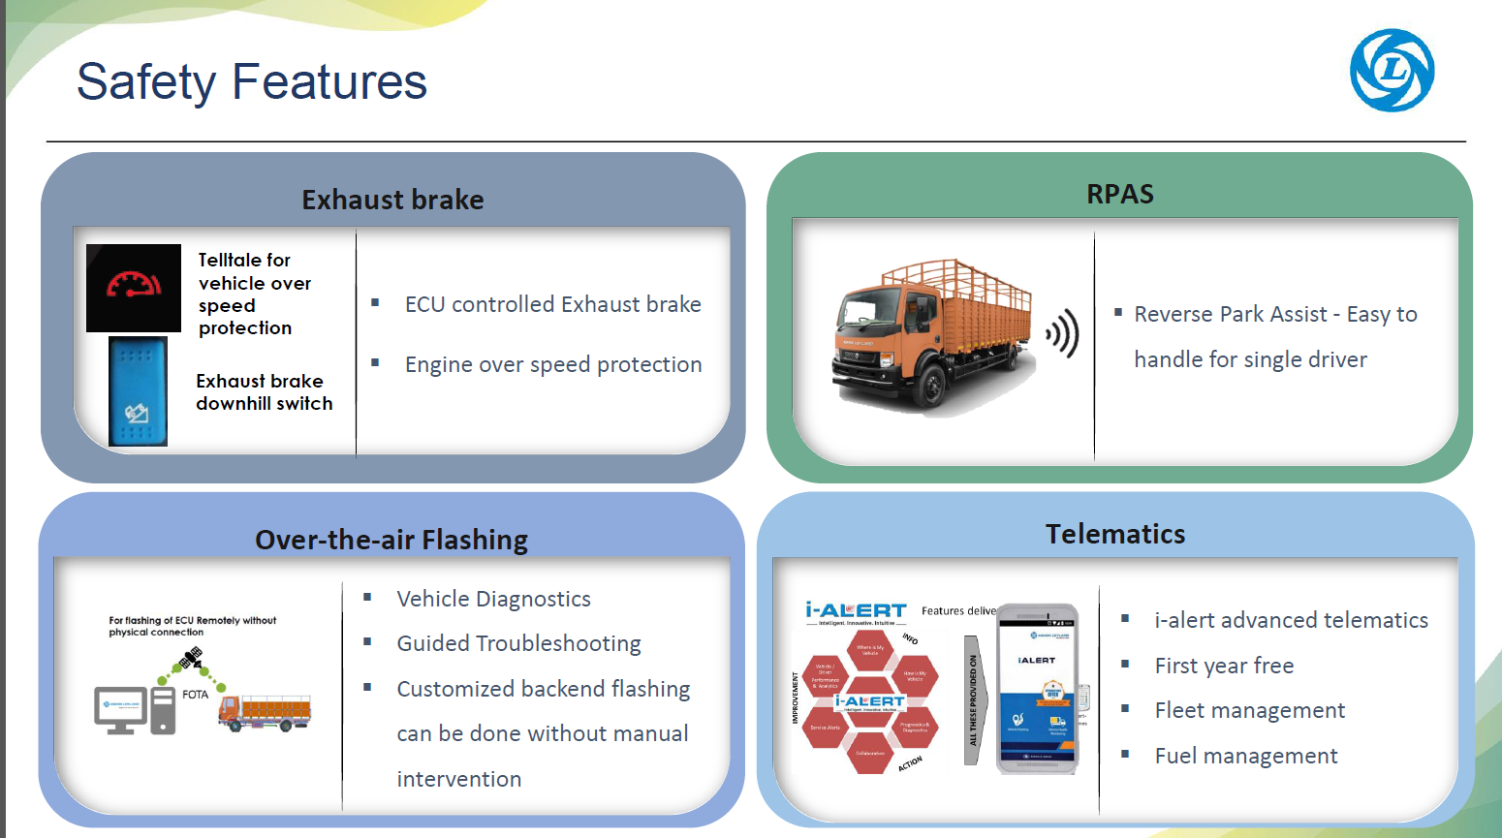

Slide 14
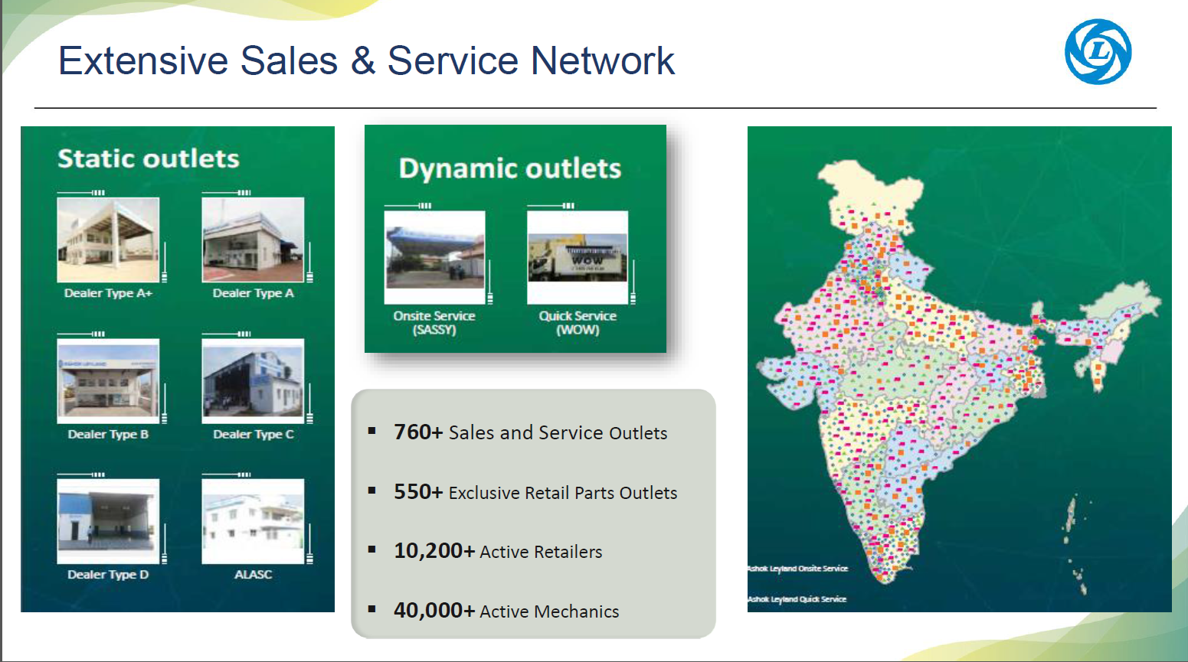

Slide 15
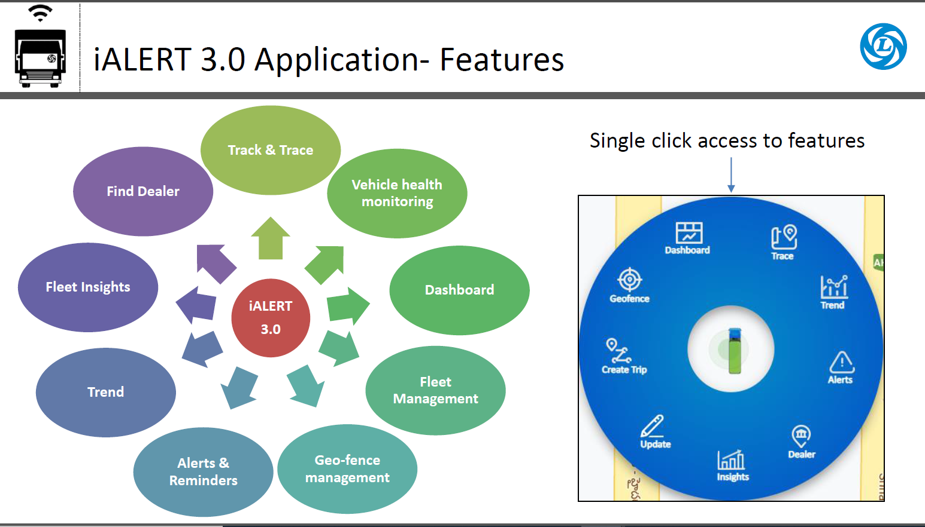

Slide 16
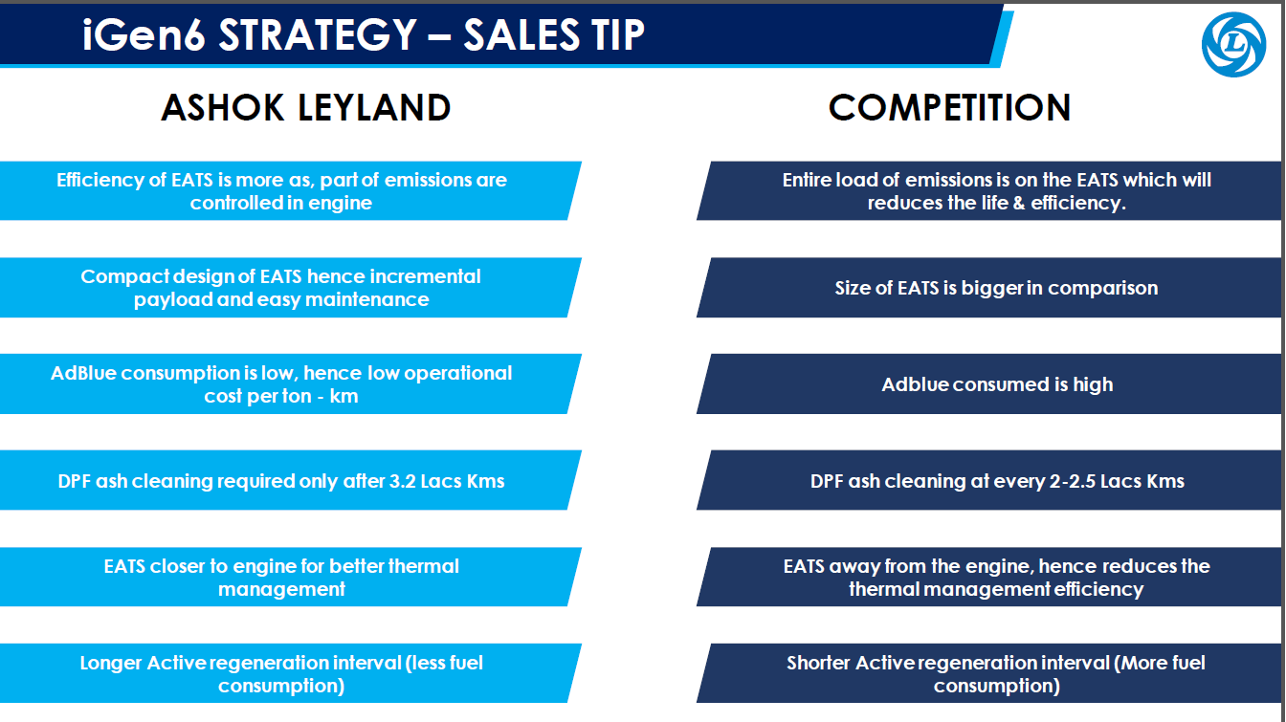

Slide 17
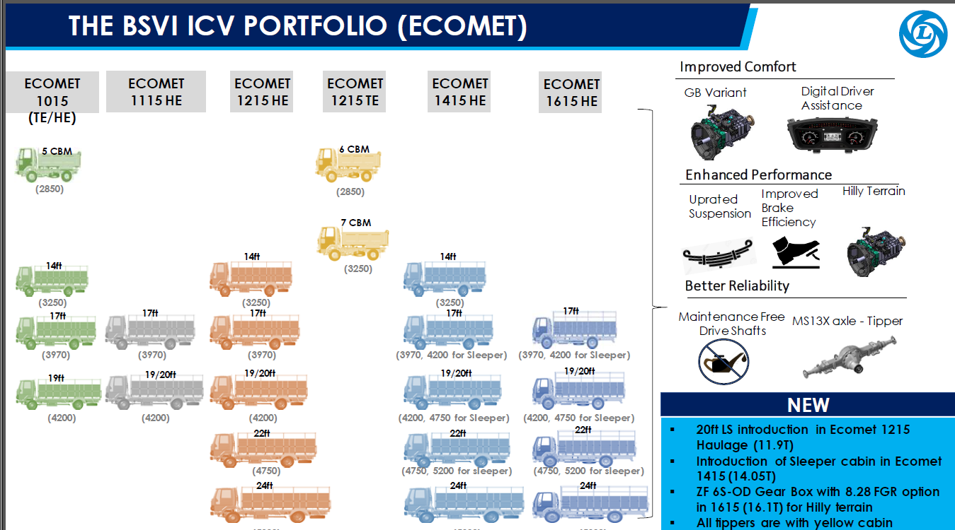

Slide 18
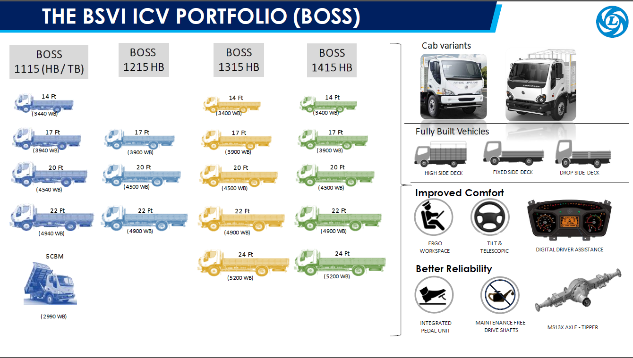

Slide 19
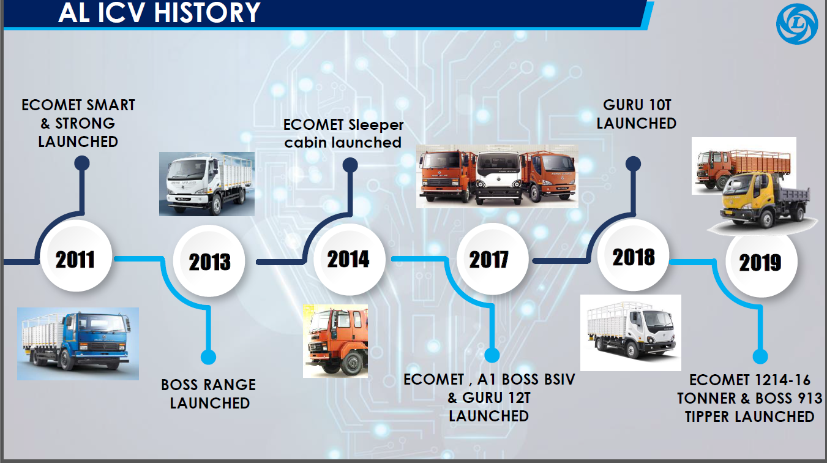

Slide 20
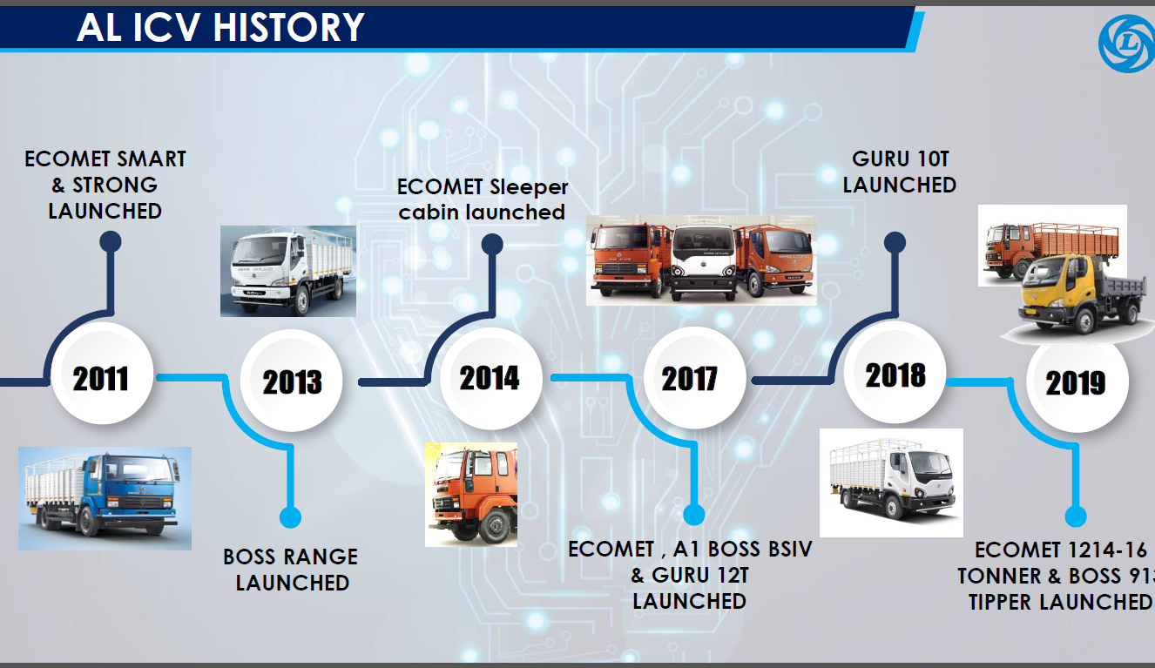

Slide 21
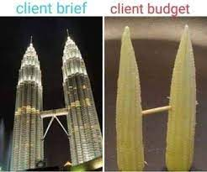
WHY PAY BETTER
Notes:
Content Slide

Slide 22
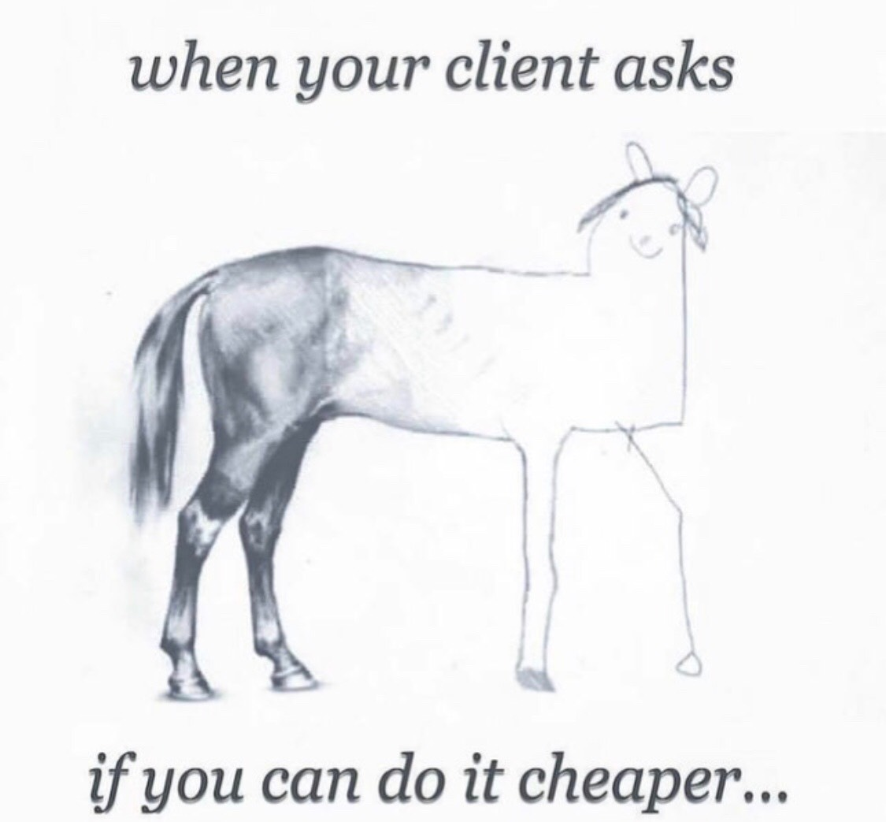
WHY PAY FOR GOOD PRODUCT

Slide 25

Notes:
End slide

